Slide 1

MAE4011 - Principle of Measurement
Seminar 3
.

Slide 2
Validation of the Chinese Dimensional Anhedonia Rating Scale in Depressed Patients in Hong Kong
Edgar Wing-ka Ching, Tin Po Chiang Jessica O. Y. Wong, Bonnie W. M. Siu, Koi Man Cheng,
Simon S. Y. Lui, and Eric F. C. Cheung

Slide 3
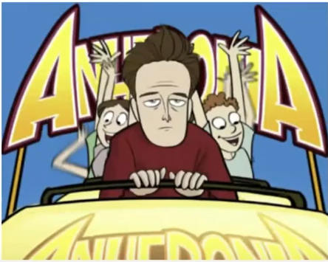
Introduction
Anhedonia is the reduced ability of an individual to experience pleasure. I
Physical Anhedonia: Absence of pleasure from non=social rewards. For example, food, money, etc
Social Anhedonia: Absence of pleasure in social activities for example being around friends, family, etc
Leads to social dysfunction
Notes:
It is present in many psychiatric illnesses such as schizophrenia, depression, substance abuse disorder,, post traumatic stress disorder
Anhedonia Paradox: Wanting something and not knowing that you want it. You only enjoy it when it is presented to you.

Slide 4
Validations Procedure outlined in study
Content Validity
An expert panel and focus group evaluated C-DARS to establish its validity
High degree of relevance and representativeness of C-DARS ie 60 – 100% agreement
Cultural appropriate examples
Participants accepted CDARS as anhedonia rating scale for its easy comprehensibility
Concurrent Validity
Expected High negative correlation (0.72) between C-DARS and SHAPS.
- higher than
Notes:
Content validity evaluates how well an instrument (like a test) covers all relevant parts of the construct it aims to measure.
Cultural appropriate examples were introduced for references
Participants accepted CDARS due to easy comprehensibility which indicated satisfactory face validity.
Concurrent validity (criterion oriented validation)—the degree to which scores on the measure are associated with scores on another measure taken at the same time.

Slide 5
Con’t
Discriminant validity
Low correlation between C-DARS and HAMD on non-social factors
High correlation between C-DARS and HAMD on social activities
Notes:
Correlation between CDARS and HAMD = -0.34 and significant p < 0.001
HAMD = Hamilton depression rating scale
C-DARS = Chinese Dimensional Anhedonia Rating Scale
SHAPS = Snaith–Hamilton Pleasure Scale

Slide 6
Test Scores
Correlation analysis of C-DARS total and subscale with SHAPS, HAMD, age and duration of illness
Variables | SHAPS | HAMD | Age | Gender | Duration of illness
C-DARS total | -.72 | -.34 | .18 | -.08 | .084
Pastimes/Hobbies | -.63 | -.39 | .13 | -.03 | .10
Food and Drink | -.45 | -.02 | .10 | -.10 | -.05
Social Activities | -.60 | -.44 | .12 | -.05 | .01
Sensory Experiences | -.60 | -.22 | .14 | -.07 | .16
Age, Gender and duration of illness appeared to be insignificant in the rate of anhedonia
Notes:
Hams = presence of depression
C-dars = presence of anhedonia
Early identification of patients with hedonic deficits would facilitate treatment planning

Slide 7
Conclusion
* C-DARS confirms results from DARS.
* Concurrent Validity satisfied with low correlation with HAMD

